Slide 1
Module 1: Introduction to Machine Learning
Machine Learning
Types of Machine Learning
Issues in Machine Learning
Applications of Machine Learning
Steps in developing a Machine Learning Application
University Question Paper Weightage:
May 2019: 15 Marks
Dec 2019: 5 Marks

Slide 2
Learning
“Learning is any process by which a system improves performance from experience.”
-Herbert Simon
“Learning is making useful changes in our minds.”
–Marvin Minsky

Slide 3
Machine Learning
Definition by Tom Mitchell (1998):
Machine Learning is the study of algorithms that
improve their performance P
at some task T
with experience E.
A well-defined learning task is given by <P, T, E>.

Slide 4
What is Machine Learning?
The complexity in traditional computer programming is in the code (programs that people write). In machine learning, algorithms (programs) are in principle simple and the complexity (structure) is in the data. Is there a way that we can automatically learn that structure? That is what is at the heart of machine learning.
-- Andrew Ng
That is, machine learning is the about the construction and study
of systems that can learn from data. This is very different than
traditional computer programming.

Slide 5
The Same Thing Said in Cartoon Form
Traditional Programming
Machine Learning
Data
Computer
Output
Program
Data
Computer
Program
Output

Slide 6
When Do We Use Machine Learning?
ML is used when:
Human expertise does not exist (navigating on Mars),
Humans are unable to explain their expertise (speech recognition)
Solution changes in time (routing on a computer network)
Solution needs to be adapted to particular cases (user biometrics)
Machine Learning isn’t always useful:
• There is no need to “learn” to calculate payroll

Slide 9
basic for comparison | Data mining | Machine learning
Meaning | Extracting knowledge from a large amount of data | Introduce new algorithm from data as well as past experience
History | Introduced in 1930, initially referred as knowledge discovery in databases | introduced in near 1950, the first program was Samuel’s checker-playing program
Responsibility | Data mining is used to get the rules from the existing data. | Machine learning teaches the computer to learn and understand the given rules.
Origin | Traditional databases with unstructured data | Existing data as well as algorithms.
Implementation | We can develop our own models where we can use data mining techniques for | We can use machine learning algorithm in the decision tree, neural networks and some other area of artificial intelligence.
Nature | Involves human interference more towards manual. | Automated, once design self-implemented, no human effort
Application | used in cluster analysis | used in web search, spam filter, credit scoring, fraud detection, computer design
Abstraction | Data mining abstract from the data warehouse | Machine learning reads machine
Techniques involve | Data mining is more of a research using methods like machine learning | Self-learned and trains system to do the intelligent task.
Scope | Applied in the limited area | Can be used in a vast area.

Slide 10
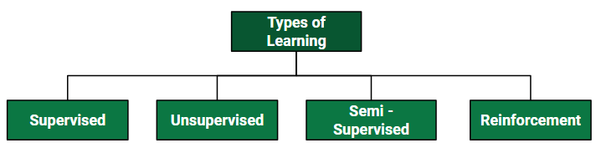

Slide 11
Supervised Learning
Supervised learning as the name indicates the presence of a supervisor as a teacher.
Supervised learning is when the model is getting trained on a labelled dataset.
Labelled dataset is one which have both input and output parameters. In this type of learning both training and validation datasets are labelled.
Supervised Learning Algorithms:
Classification
Regression

Slide 12
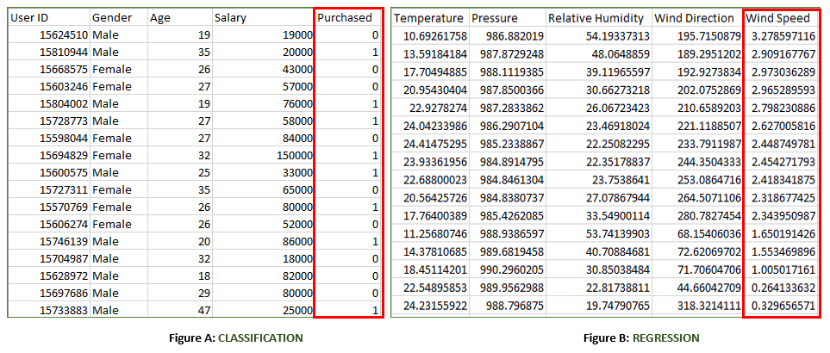
Both the above figures have labelled data set –
Figure A: It is a dataset of a shopping store which is useful in predicting whether a customer will purchase a particular product under consideration or not based on his/ her gender, age and salary. Input : Gender, Age, Salary Output : Purchased i.e. 0 or 1 ; 1 means yes the customer will purchase and 0 means that customer won’t purchase it.
Figure B: It is a Meteorological dataset which serves the purpose of predicting wind speed based on different parameters. Input : Dew Point, Temperature, Pressure, Relative Humidity, Wind Direction Output : Wind Speed

Slide 13

Unsupervised Learning
Unsupervised learning is the training of machine using information that is neither classified nor labeled and allowing the algorithm to act on that information without guidance.
Here the task of machine is to group unsorted information according to similarities, patterns and differences without any prior training of data.
Unlike supervised learning, no teacher is provided that means no training will be given to the machine.
Therefore machine is restricted to find the hidden structure in unlabeled data by our-self.
Unsupervised learning classified into two categories of algorithms:
Clustering: A clustering problem is where you want to discover the inherent groupings in the data, such as grouping customers by purchasing behavior.
Association: An association rule learning problem is where you want to discover rules that describe large portions of your data, such as people that buy X also tend to buy Y.

Slide 14
Semi-supervised learning
In this type of learning, the algorithm is trained upon a combination of labeled and unlabeled data.
Typically, this combination will contain a very small amount of labeled data and a very large amount of unlabeled data.
The basic procedure involved is that first, the programmer will cluster similar data using an unsupervised learning algorithm and then use the existing labeled data to label the rest of the unlabeled data.
Applications
Speech Analysis: Labelling of audio files
Internet Content Classification: Labelling each web page

Slide 15
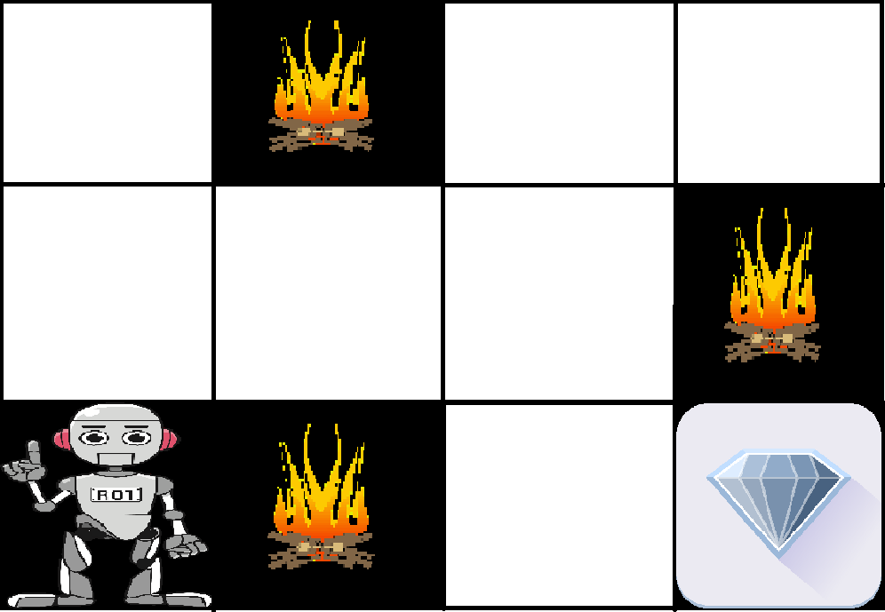
Reinforcement Learning
It is about taking suitable action to maximize reward in a particular situation.
It is employed by various software and machines to find the best possible behavior or path it should take in a specific situation.
Reinforcement learning differs from the supervised learning in a way that in supervised learning the training data has the answer key with it so the model is trained with the correct answer itself whereas in reinforcement learning, there is no answer but the reinforcement agent decides what to do to perform the given task.

Slide 16
Supervised Vs Unsupervised Learning
Supervised Learning | Unsupervised Learning
It has teacher / supervisor | It does not have teacher / supervisor
Uses known and labelled data | Uses unknown and unlabelled data
Very complex to develop | Less complex to develop
Uses off-line analysis | Uses real-time analysis
Number of classes are known | Number of classes are unknown
Gives accurate and reliable results | Gives moderately accurate and reliable results
e.g. Classification, Regression | e.g. clustering, association

Slide 17
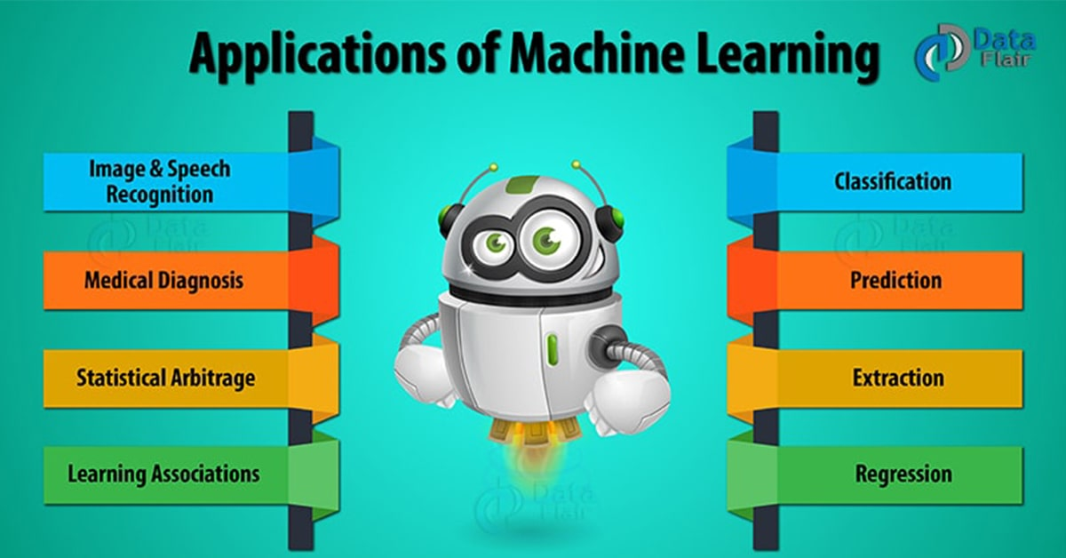
Machine Learning Applications

Slide 18
Steps for developing machine learning applications
Problem framing
Collect and clean the data
Prepare data for ML application
Feature engineering
Training a model
Evaluating and improving model accuracy
Serving with a model in production
Wrapping up
Notes:
Building a machine learning application is an iterative process and follows a set of sequences. Below are the steps involved in for developing machine learning applications:
Problem framing
This first step is to frame a machine learning problem in terms of what we want to predict and what kind of observation data we have to make those predictions. Predictions are generally a label or a target answer; it may be a yes/no label (binary classification) or a category (multiclass classification) or a real number (regression).
Collect and clean the data
Once we frame the problem and identify what kind of historical data we have for prediction modeling, the next step is to collect the data from a historical database or from open datasets or from any other data sources.
Not all the collected data is useful for a machine learning application. We may need to clean the irrelevant data, which may affect the accuracy of prediction or may take additional computation without aiding in the result.
Prepare data for ML application
Once the data ready for the machine learning algorithm, we need to transform the data in the form that the ML system can understand. Machines cannot understand an image or text. We need to convert it into numbers. It also requires building data pipeline depending on the machine learning application needs.
Feature engineering
Sometimes a raw data may not reveal all the facts about the targeted label. Feature engineering is a technique to create additional features combining two or more existing features with an arithmetic operation that is more relevant and sensible.
For example: In a compute engine, it is common for RAM and CPU usage to reach 95%, but something is messy when RAM usage is at 5% and CPU is at 93%. We can use a ration of RAM to CPU usage as a new feature, which may provide a better prediction. If we are using deep learning, it will automatically build features itself; we do not need explicit feature engineering.
Training a model
Before we train the model, we need to split the data into training and evaluation sets, as we need to monitor how well a model generalizes to unseen data. Now, the algorithm will learn the pattern and mapping between the feature and the label.
The learning can be linear or non-linear depending upon the activation function and algorithm. There are a few hyper parameters that affect the learning as well as training time such as learning rate, regularization, batch size, number of passes (epoch), optimization algorithm, and more.
Evaluating and improving model accuracy
Accuracy is a measure to know how good or bad a model is doing on an unseen validation set. Based on the current learnings, we need to evaluate how a model is doing on a validation set. Depending on the application, we can use different accuracy metrics. For e.g. for classification we may use, precision and recall or F1 Score; for object detection, we may use IoU (interaction over union).
If a model is not doing well, we may classify the problem in either of class 1) over-fitting and 2) under-fitting.
When a model is doing well on the training data, but not on the validation data, it is the over-fitting scenario. Somehow model is not generalizing well. The solution for the problem includes regularizing algorithm, decreasing input features, eliminating the redundant feature, and using resampling techniques like k-fold cross-validation.
In the under-fitting scenario, a model does poor on both training and validation dataset. The solution to this may include training with more data, evaluating different algorithms or architectures, using more number of passes, experimenting with learning rate or optimization algorithm.
After an iterative training, the algorithm will learn a model to represent those labels from input data and this model can be used to predict on the unseen data.
Serving with a model in production
After training, the model will do well on the unseen data and now it can be used for prediction. This is the most important thing for businesses. This is also one of the most difficult phases for business-oriented machine learning applications. In this phase, we deploy the model in production for the prediction on real-world data to derive the results.
Wrapping up
Machine learning is the enabler technology, but if we do not follow a proper plan and execution for training and learning of models on algorithms, we may fail. Hence, it is always a great idea for businesses that want to build complex machine learning systems to hire AI and Machine learning service providers and focus on their core competency.

